Slide 1


Engaging with AI Tools in Your Course: Strategies for Integrating and Monitoring Generative AI
Racheal Fest
Chilton ReyNolds

Slide 2
Agenda
Introductions
Quick Intro to Generative AI
Developing aN Approach to AI
Integrating AI in your course
Monitoring AI use & Rethinking the Classroom
Notes:
Racheal

Slide 3

Introductions
Name
Department
Familiarity with AI, interest in this session, or questions about AI for your teaching
Notes:
Racheal

Slide 4

What is Generative AI and Why is everyone talking about it?
Notes:
Chilton

Slide 5
Generative Ai
What it is
Why it matters
Tools like ChatGPT and Bard, which can:
  Write papers
  Answer questions
  Pass exams
  And more
Large Language Processing Model (LLM)
Generative Pre-Trained Transformer (GPT)
Students are using AI now
Studies predict it’s about to transform work
LLMs are developing rapidly
Notes:
Chilton

Slide 6
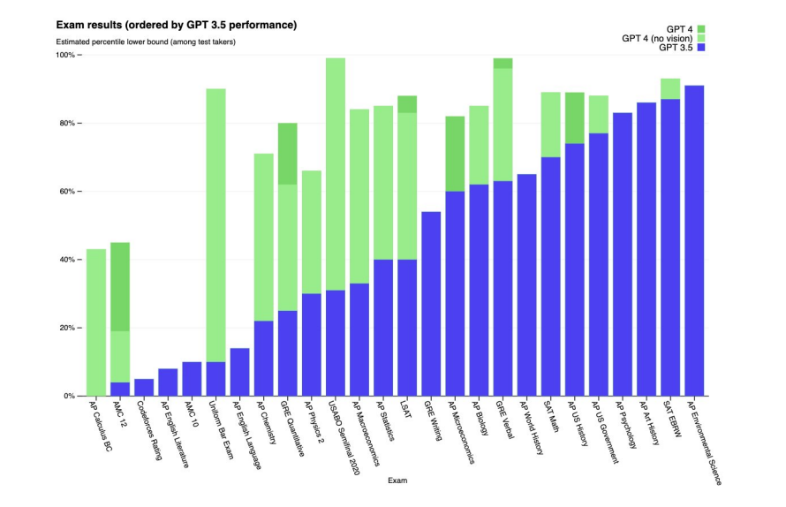
GPT 3.5 vs. 4 Exam Performance
GPT 4 has passed the Bar Exam. Notice the low performance on AP English Language and Literature
Notes:
Chilton

Slide 7
Developing an Approach to AI
How are you thinking about approaching AI in your classroom?
Opposition
Celebration/adoption
Rueful, cautious, or informed engagement
Notes:
Racheal (opposition by ignoring won’t be possible, adopting without preserving room for things like the writing process might not serve students, so, we’re thinking in the TLTC about how to both preserve space for traditionally valued activities, like writing as thinking, and how to incorporate AI so that we’re teaching students how to engage with these tools

Slide 8
Resources: Developing an Approach to AI
No, Not Really
Yes, Please
Critical AI: Adapting College Writing for the Age of Large Language Models—Some Next Steps for Educators
ChatGPT Should Not Exist
ChatGPT Writes Answers
GPTs are GPTs: An early look at the labor market impact potential of large language models
Ditch That Textbook (general ed, many ideas)
Update Your Syllabus for ChatGPT
Meet the New TA in My Classroom—ChatGPT!
Notes:
Racheal

Slide 9
Getting Started with AI
Go
Go to OpenAI’s website and create an account to use ChatGPT
Prompt
Enter your prompts for essays, exams, assignments
Improve
Try prompting the tool to improve responses
Update
Consider what updates to your teaching and policies might make sense
Notes:
Racheal

Slide 10

Integrating AI Tools
Notes:
Chilton

Slide 11
Integrating AI in Your Coursse
In class, critically engage with the concept of AI
  Situate it historically
  AI is not AI—politics and consequences of labels
  Evaluate its strengths and limitations
Critically engage with AI outputs (form, content)
Teach AI literacy—how to compose with AI, how to prompt AI to revise
Notes:
Chilton

Slide 12
AI Assignments
Teach students how to use AI and develop strategies for prompting a tool like ChatGPT.
Compare student and AI responses and discuss differences, strengths, and challenges, with option to develop and use a rubric together.
Solicit content from ChatGPT and evaluate its formal features.
Ask students to use ChatGPT to generate content knowledge and then evaluate that knowledge.
Talk with students about when to use AI and when not to. Create prompts with options to use AI, as well as options not to.
Notes:
Chilton and Racheal and audience

Slide 13
Monitoring AI & Rethinking the Classroom

Slide 14
SUNY Oneonta Academic Dishonesty
“Academic dishonesty is defined as any act by a student that misrepresents or attempts to misrepresent to an instructor or any University official, the proficiency or achievement of that student or another student in any academic exercise, or that is intended to alter any record of a student’s academic performance by unauthorized means.”
“Using quotations without identification as such or paraphrasing without specific identification of the source”
Code of Student Conduct, https://suny.oneonta.edu/policy-library/policies-z/code-student-conduct#article2
Notes:
Racheal

Slide 15
MonitorinG AI & Rethinking the Classroom
Course Policy. Begin by talking with students about your expectations. How will you treat AI use? What do you expect and why? Invite students to help create your AI policy and discuss options. Include an explicit policy in your syllabus
Revised assignments. Reflect on your writing prompts and course deliverables. Redesign or improve them so that ChatGPT can’t do them. Assign videos. Engage very recent texts. Emphasize personal reflection.
Notes:
Chilton

Slide 16
MonitorinG AI & Rethinking the Classroom
Process-based assignments. Emphasize the writing process. Use formative assessment to get to know students. Collect writing samples. Ask students to use “Track Changes.” in their documents.
Flipped classroom. Require students to work on writing assignments and other course deliverables in class.
Notes:
Racheal

Slide 17
AI Detection: Current and Future Tools
Turnitin
GPTZero
Copyleaks
AI Text Classifier (by OpenAI)
Originality.ai
Others
Notes:
Chilton

Slide 18
Considerations
AI might not remain free
AI will continue to evolve
AI reproduces existing biases (despite “training”), relies on unremunerated labor of writers and artists, and traumatizes workers in the global south tasked with “training” it
Students are already using it like Google
We can incorporate AI without using it to replace student activities. We might not be able to oppose it by ignoring it.
Notes:
Racheal

Slide 19
Thoughts, Questions, Concerns?
Notes:
Racheal

Slide 22
Ai Assignments
Rethink assessment: don’t default to written text. Consider video or audio reflections
Formative assessment: focus more on process. Give feedback on writing at earlier stages and help students track progress
Use ”Version History” to take a look at a document’s evolution
Involve students in drafting a policy on AI
Ask students how they’re already using AI
Invite students to think critically about how using AI changes a task, and ask them to assess the costs and benefits

Slide 23
GPTs are GPTs: An early look at the labor market impact potential of large language models
LLMs such as GPTs are general-purpose technologies, meaning they are likely to have large-scale economic, social, and policy implications
80% of the US workforce could have at least 10% of work tasks impacted
19% of workers could see 50% of tasks impacted
15-56% of all worker tasks could be completed more quickly at the same level of quality (with LLMs and software)
Higher income jobs might face greater impact

